Slide 1

BCA Connect
Time: 9:30 - 10:30 am

Slide 2
Table of contents
BCA Intro
Students Connect
01
02
Community Explore
Company Culture
And Job Roles
03
04
6th sem
5min
6th sem
30 min
4th sem
15min
6th sem
15min

Slide 3
Whoa!
President: I am Bibek Gupta, a BCA student and Full Stack developer. I am focused explorer
and hustler to achieve career growth and goals.
Vice-President: I am Bipul Khatiwada, a BCA student and FrontEnd developer. I am focused explorer and hustler to achieve career growth and goals.

Slide 4
01
BCA INTRO
5 min
Bipul Khatiwada

Slide 5
BCA
BCA -> Application Developer
CSIT-> Researcher
BE.CS -> High level Program Engineer. Eg developing programming language

Slide 6
BCA Club
For student engagement and student collaboration:
Software Club
Graphics Club
Sports Club
Robotics Club

Slide 7
02
Student Connect
30 min
Bibek Gupta

Slide 8

Word of Mouth

Slide 9
Possibilities
Name
Career
In future
Effects
Your name
Goals (current)
What u see in future after 4 yrs.

Slide 10
03
Community Explore
10 min
Naseeb Dangi

Slide 11
Community is global
Globally
Connect

Slide 12
College Ambassador Program
Here’s an assortment of alternative resources whose style fits that one of this template:
Programs:
Github Campus Expert
Microsoft Student Partner
AWS Student Ambassador

Slide 13
Important skills
Social
Academic
Career
College
Transition

Slide 14
04
Company Culture
And job roles
15 min
Bibek Gupta

Slide 15
Job and career in Nepal
Development
Managerial
Project manager –> Top executive
Junior –> Senior

Slide 16
Possible Tech Area
Fullstack
DataScience
Cloud
System Expert
Security
Devops
Design

Slide 17
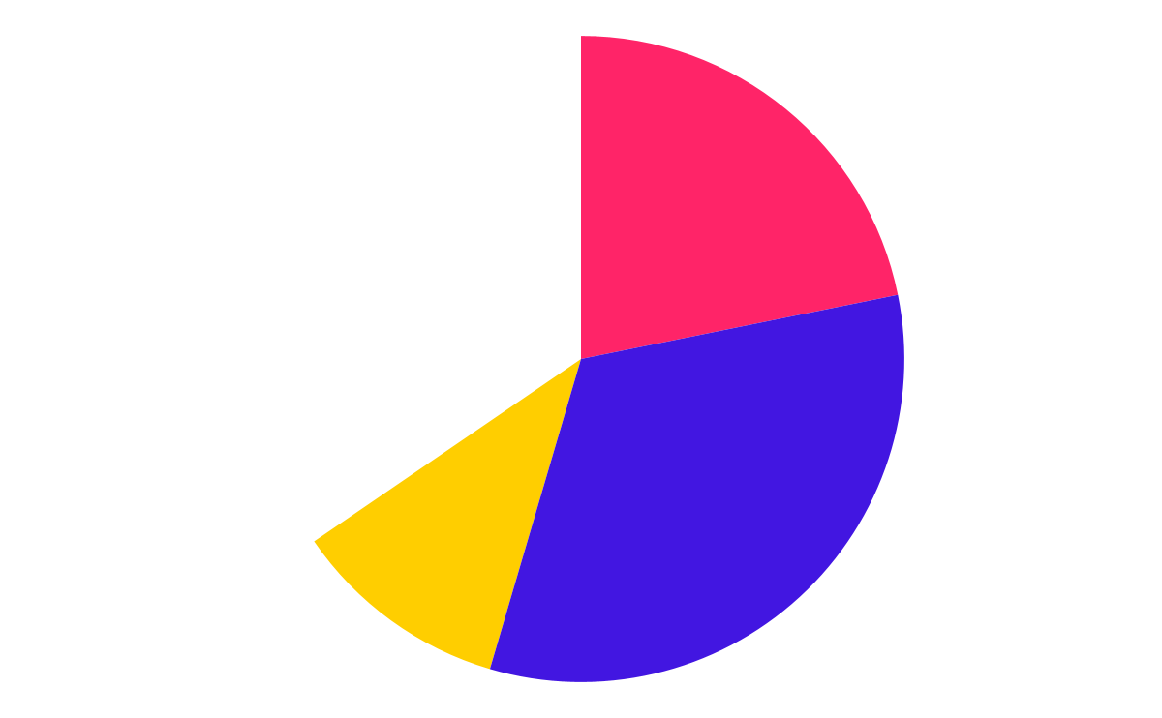

Skills in students through Projects
Group Projects
Positive mind
Thinking skills
Communic.
Personal skills

Slide 18
Things you should know
Free Stuffs:
Free Hot tech news:
Free Tips For Future Devs:
https://education.github.com/pack -> resources
https://learngitbranching.js.org -> github
https://b-ok.asia or http://libgen.rs -> books
https://www.coursera.org/for-university-and-college-students -> resourcess
https://news.ycombinator.com
Procrastination -> Clear basics fast

Slide 19
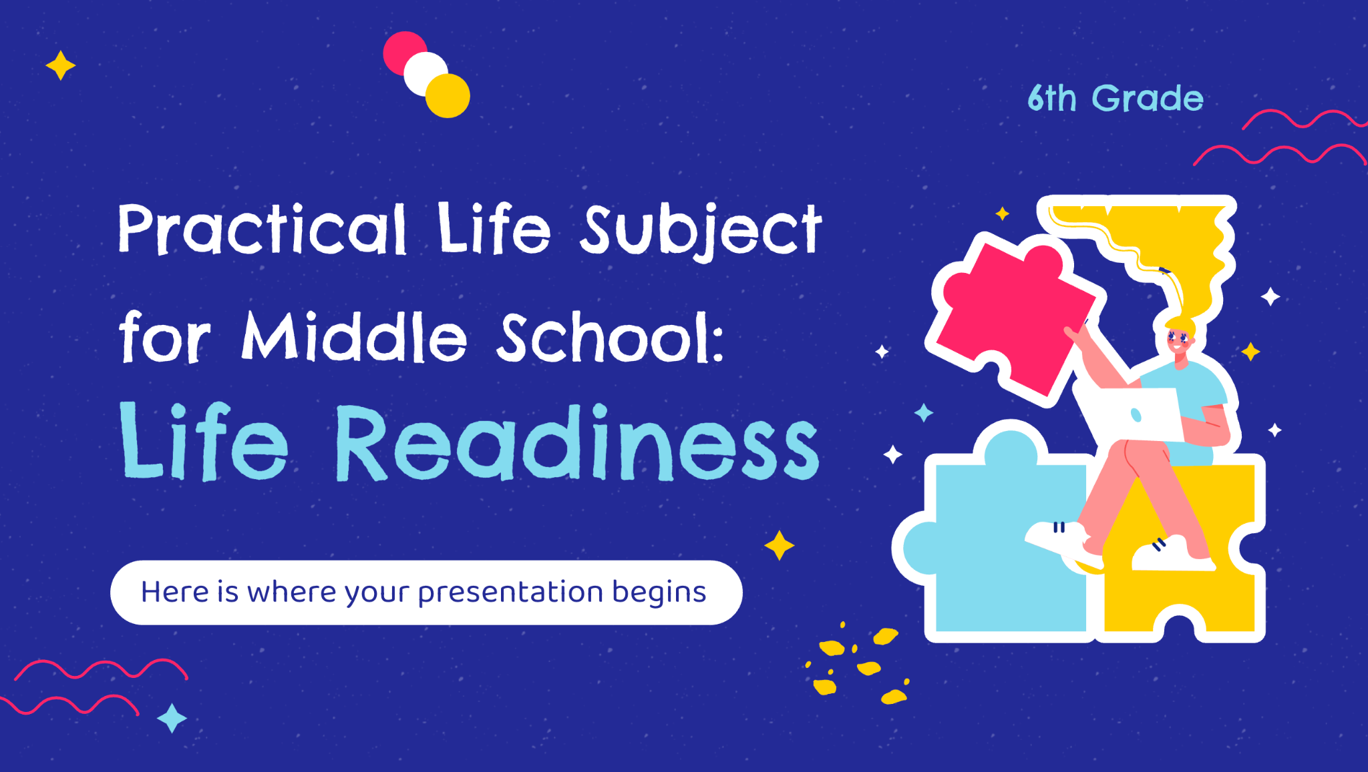
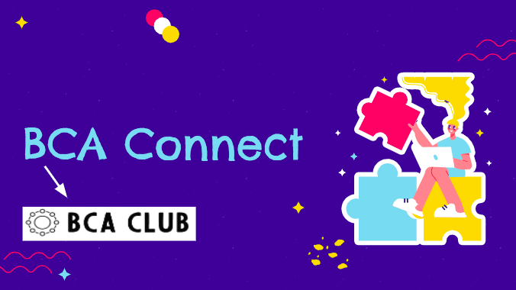
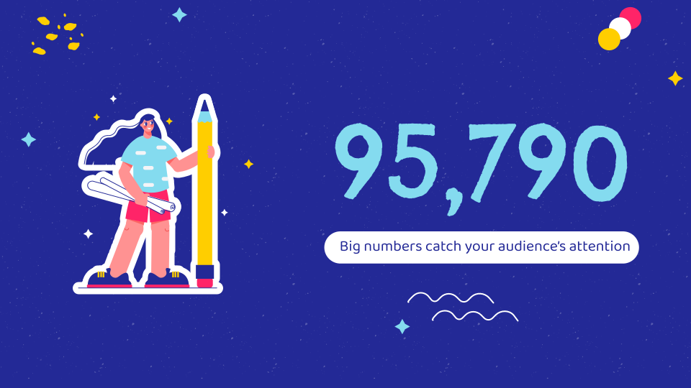
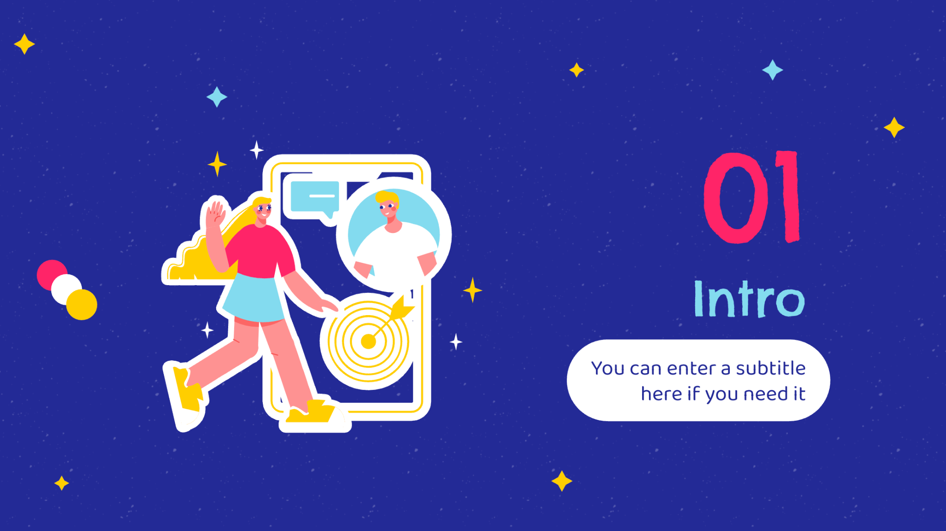
Software
Mobile
web
App

Slide 20
Thanks!

